Slide 1


Project-2 Fatal Police Encounters
Archna Ashish
Rick Shevlin
Hasti Patel
Bryan Wilson

Slide 2
SCOPE
The scope of the project is to highlight the number of police encounters that have resulted in fatalities.
The project aims to demonstrate these numbers by race, gender, state, and age of the deceased.
In addition, the project has attempted to identify whether the victim was suffering from any mental illness.
Another variable that the project has chosen to highlight is, ‘the cause of death’, to determine how many people were killed as a result of active police shooting.

Slide 3

Data Sources
Fatal Police Shootings in the US | https://www.kaggle.com/kwullum/fatal-police-shootings-in-the-us
US Police Violence and Fatal Shootings | https://www.kaggle.com/jpmiller/police-violence-in-the-us

Slide 4
Workflow
Data Gathering using Kaggle as the primary source
Data Wrangling- using PANDAS
Data Loading- using PANDAS and PostgreSQL
Create a flask app to be served as an API for data visualization
Create a dashboard using HTML and CSS, and JS libraries: D3, Leaflet, and Chart.js to create the visualizations.

Slide 5
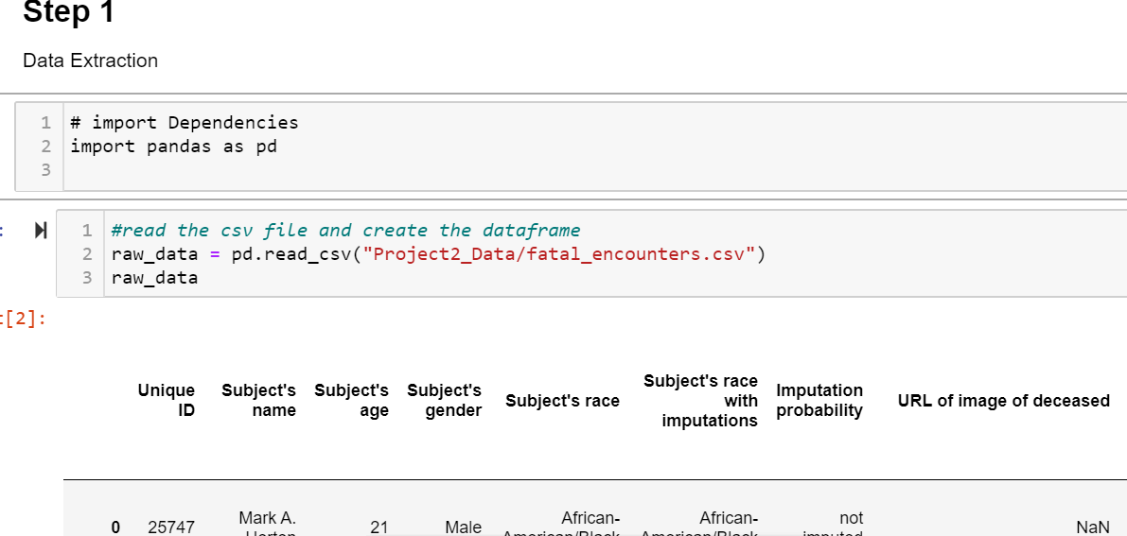
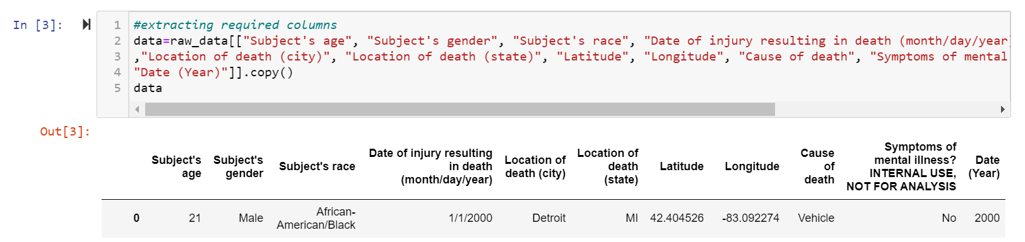
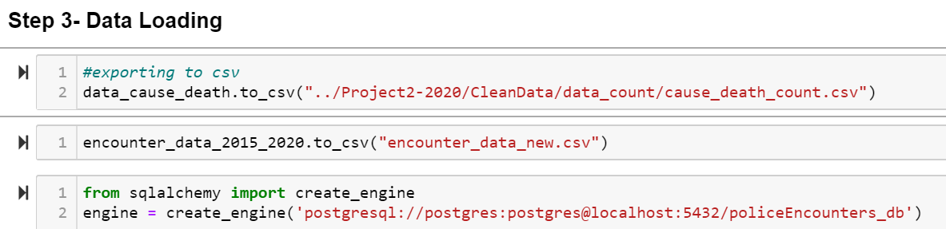
Data Extraction
Data Transformation
Data Loading

Slide 6
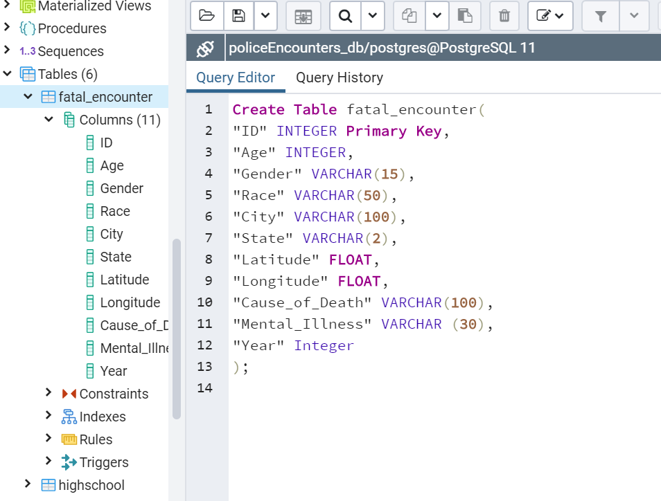

Data Modeling

Slide 7
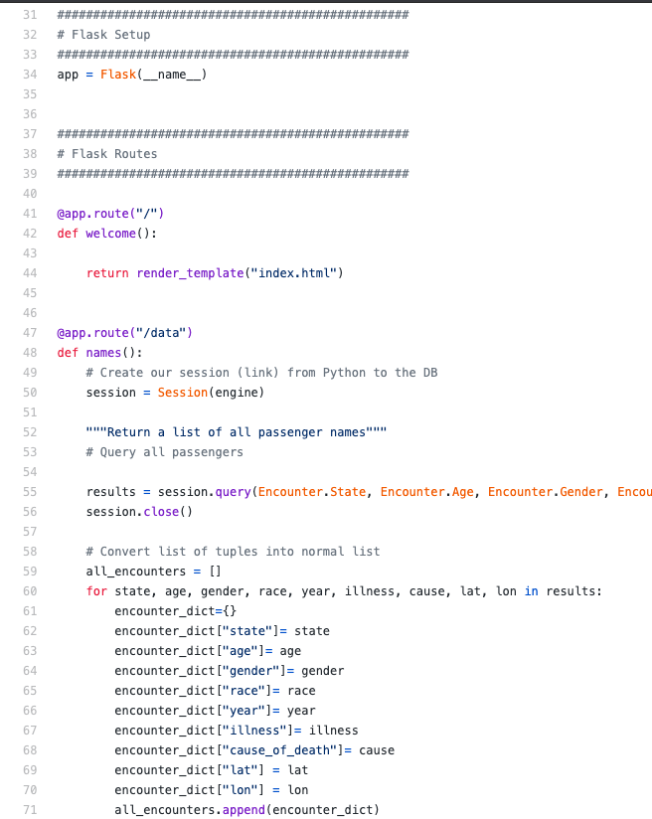
FLASK APP
Flask is a web framework.
This means flask provides you with tools, libraries and technologies that allow you to build a web application.
Create the structure of the project
Create the application file
Create the template index.html
Run the flask application
For example,
python flask_skeleton.py

Slide 8

DEMO

Slide 9
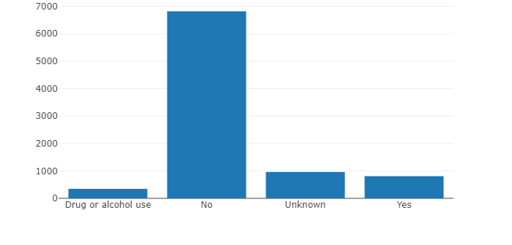
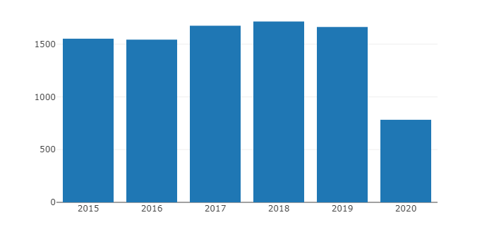
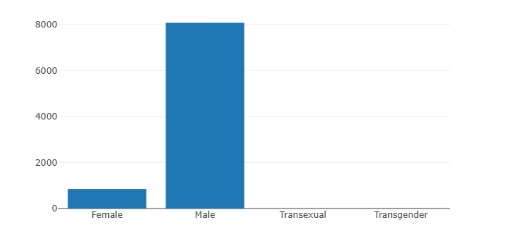
DATA ANALYSIS– Deaths by Mental Illness, Year & Gender
Mental Illness vs Number of deaths | Deaths | Cause
Maximum Deaths | 6817 | No signs of mental illness
Minimum Deaths | 346 | Drug or alcohol
Year vs Number of deaths | Deaths | Year
Maximum Deaths | 1715 | 2018
Minimum Deaths* | 783* | 2020 * (only data through June )
Gender vs Number of deaths | Deaths | Gender
Maximum Deaths | 8073 | Male
Minimum Deaths | 1 | Transsexual

Slide 10
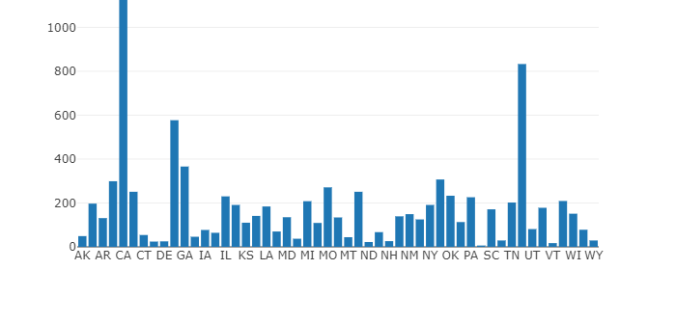
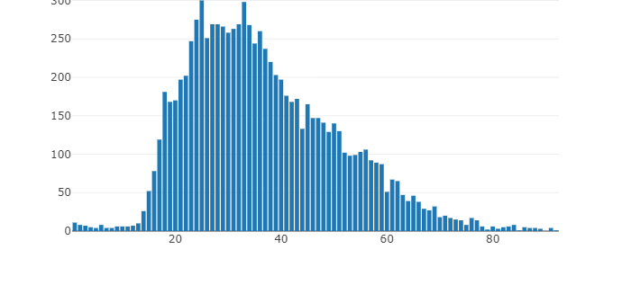
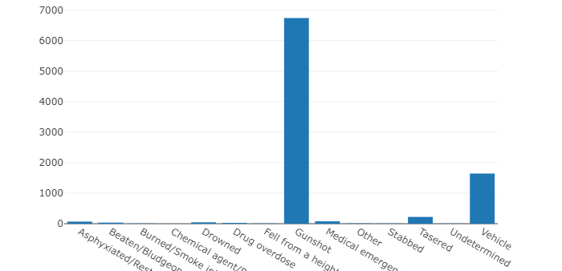
DATA ANALYSIS– Deaths by State, Ages & Cause
States vs Number of deaths | Deaths | States
Maximum Deaths | 1127 | CA (most populous state)
Minimum Deaths | 6 | RI
Ages vs Number of deaths | Deaths | Age
Maximum Deaths | 300 | 25
Minimum Deaths | 1 | 92
Cause of Deaths vs Number of deaths | Deaths | Cause
Maximum Deaths | 6739 | Gunshot
Minimum Deaths | 3 | Chemical agent/Pepper spray

Slide 11
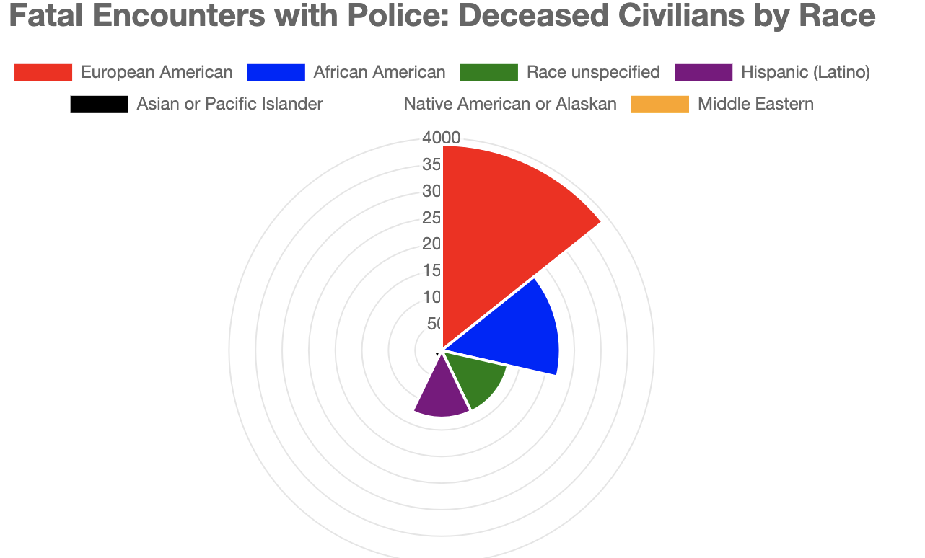
Polar area chart
Polar Area Chart describing the number of civilians killed (by race)
"European American = White Americans"

Slide 12
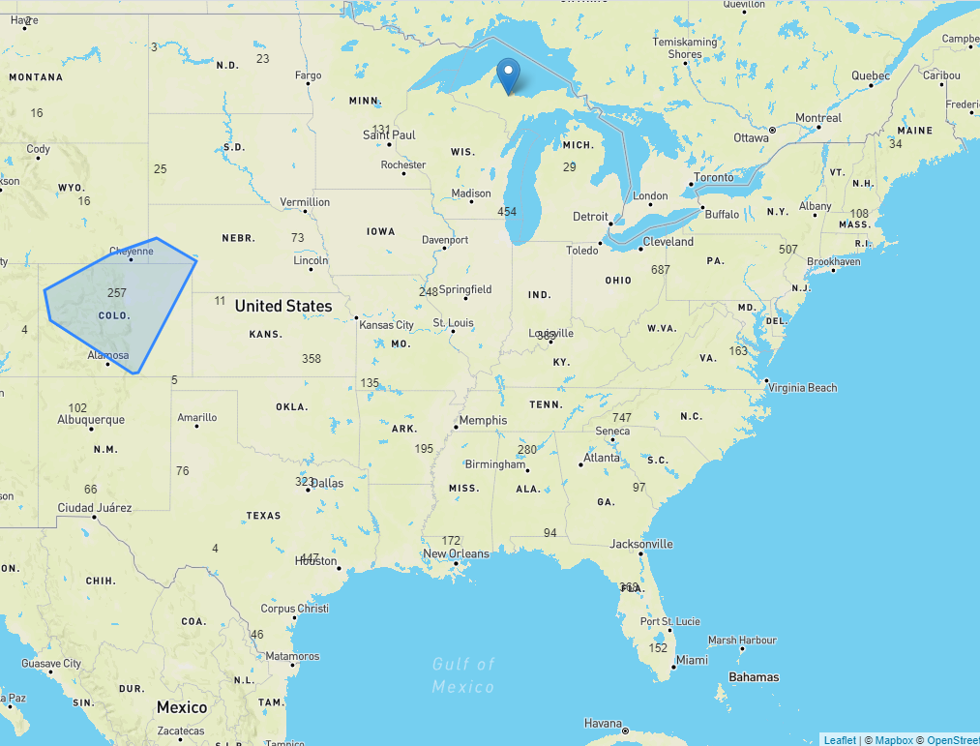
Map
We created cluster group of Popup markers
Used Race, age, sign of mental illness

Slide 13
Challenges for this project
We wanted to incorporate the number of police deaths to perform a comparative analysis, but unfortunately there was not sufficient data for us to be able to perform that study.
We wanted to investigate the impact of various factors, such as poverty, reason for police intervention, household income, level of education among others, on police killings. But again, there was insufficient or unusable data to infer that information.
Finding a JS library that wasn't used in class before and appropriate for the project purposes
Remote collaboration on the project was a bigger challenge than we had anticipated because of scheduling conflicts and sharing of database once the data was loaded into PostgreSQL

Slide 14


